Slide 1


Slide 2
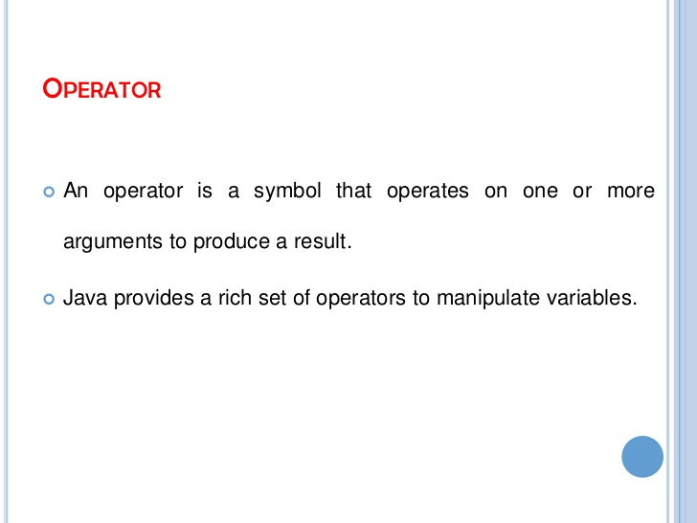
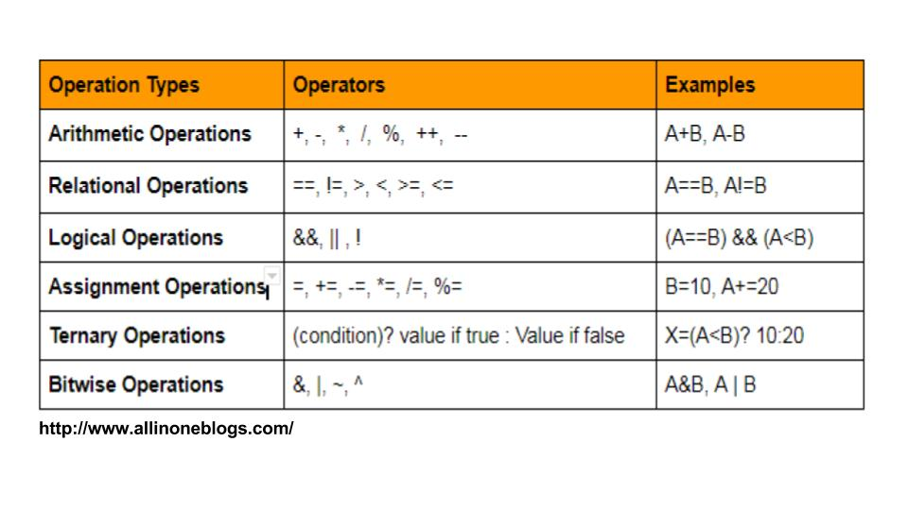

Slide 3
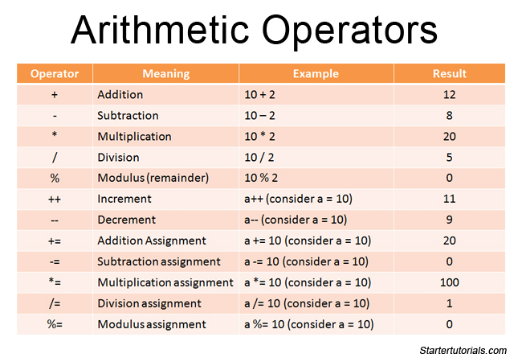
Arithmetic Operators
Arithmetic operators are used to perform mathematical operations like addition, subtraction, multiplication.

Slide 4
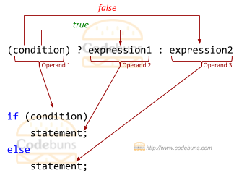
Ternary Operator
The conditional operator or ternary operator ?: is shorthand for if-then-else statement.
The syntax of conditional operator is:
variable = Expression ? expression1 : expression2
Here's how it works:
If the Expression is true, expression1 is assigned to variable.
If the Expression is false, expression2 is assigned to variable.

Slide 5
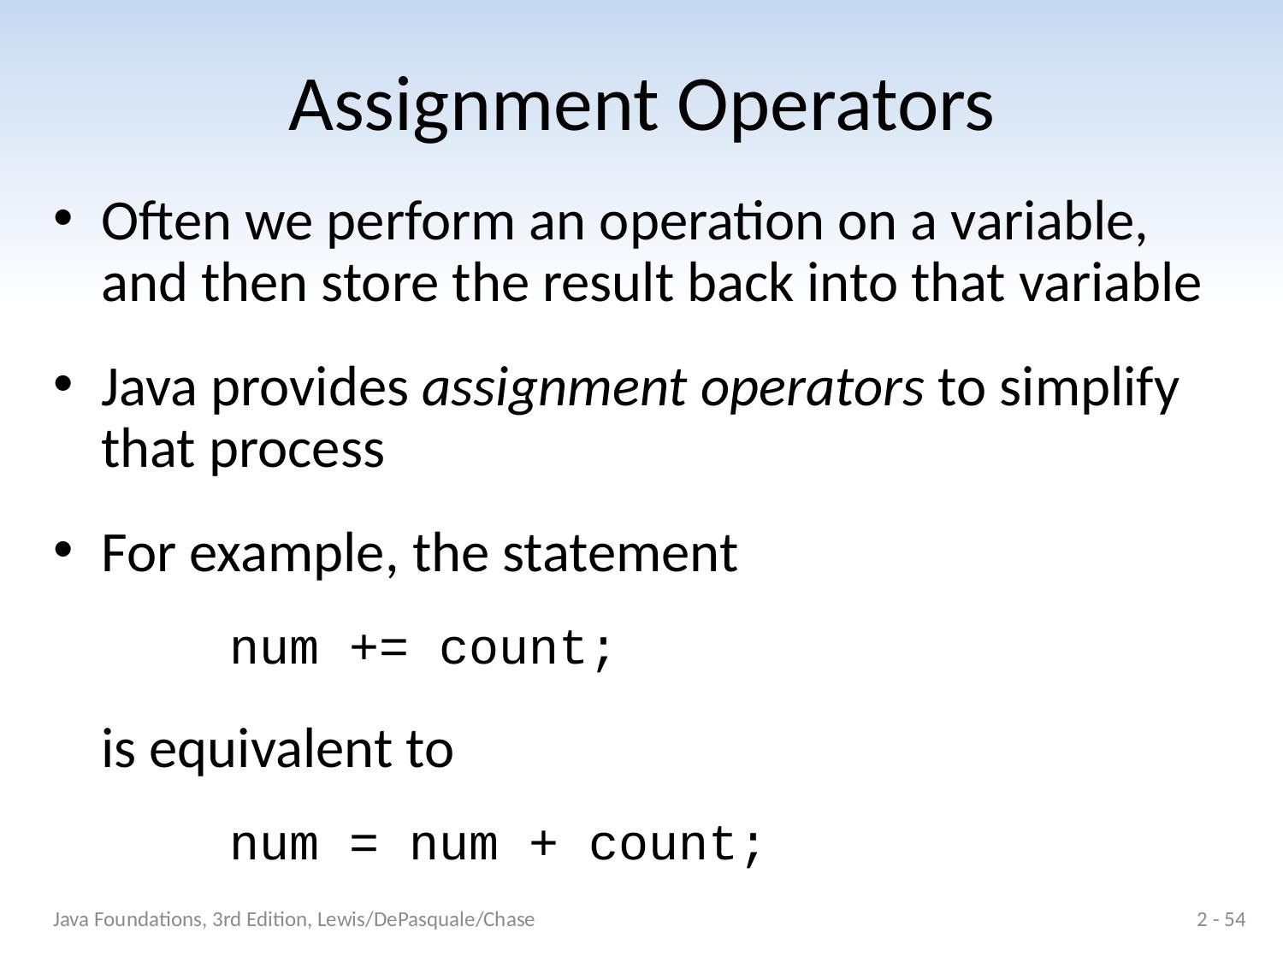
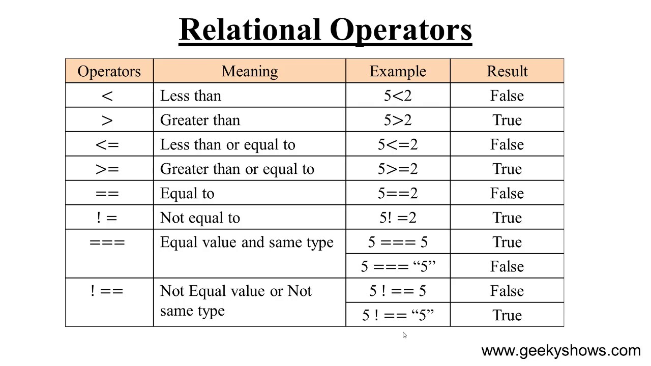

Slide 6
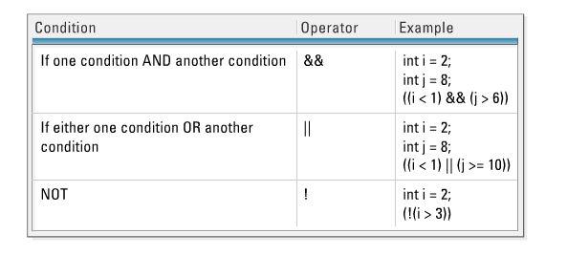
Logical Operators
The logical operators || (conditional-OR) and && (conditional-AND) operates on boolean expressions.

Slide 7
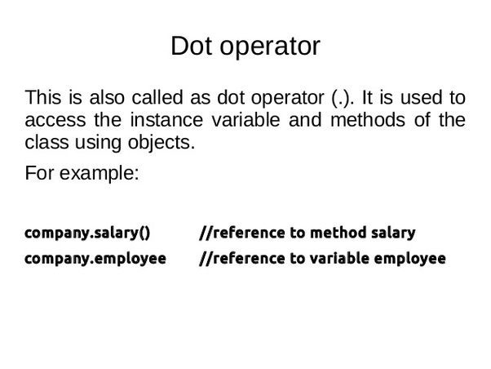
Dot Operator
The dot operator is used to determine the value of the instance variables. It has two parts namely the object on the left side of the dot and the variable on the right side of the dot . dot expression are evaluated from left to right .
<Object References>.<variable Name >
Where <object References> is the name of the object and <variable Names> is the instance variable.

Slide 8


